Slide 1

JavaScript Chapter 4: Logic Statements

Slide 2
Introduction
Up to this point, our code has been rather static. It will do the same thing every time we execute it. In this chapter, that is all going to change. We will be dealing with logical statements. Logical statements allow us to make multiple paths in our code. Depending on the outcome of a certain expression, we will follow one code path or another.
There are different logic statements, and we will go over them in this chapter. We will start with if and if else statements. After that, we will be dealing with the ternary operator, and the final one we will be dealing with is the switch statement.
Along the way, we will cover the following topics:
if and if else statements
else if statements
Conditional ternary operators
switch statements

Slide 3
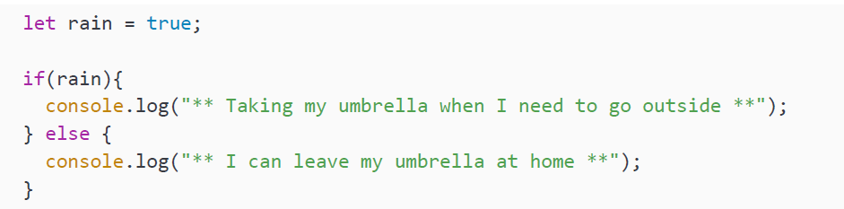
if and if else statements
We can make decisions in our code using if and if else statements. It is very much like this template:
if *some condition is true*, then *a certain action will happen*, else *another action will happen*
For example, if it is raining then, I will take my umbrella, else I will leave my umbrella at home. It is not that much different in code:
In this case, the value of rain is true. And therefore, it will log to the console:

Slide 4
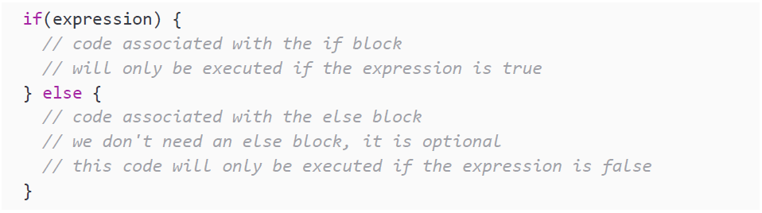
if and if else statements
But let's first take a step back and look at the syntax. We start with the word "if." After this, we get something within parentheses. Whatever is between these parantheses will be translated to a Boolean. If the value of this Boolean is true, it will execute the block of code associated with if. You can recognize this block by the curly braces.
The next block is optional; it is an else block. It starts with the word "else" and is only executed in case of the Boolean having the value false. If there is no else block and the condition evaluates to false, the program will just skip ahead to the code underneath the if.
Only one of these two blocks will be executed; the if block when the expression is true, and the else block when the expression is false:

Slide 5
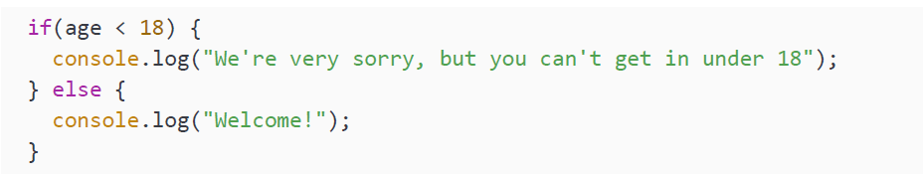
if and if else statements
Here is another example. If the age is below 18, log to the console that access is denied, otherwise log to the console that the person is allowed to come in:

Slide 6
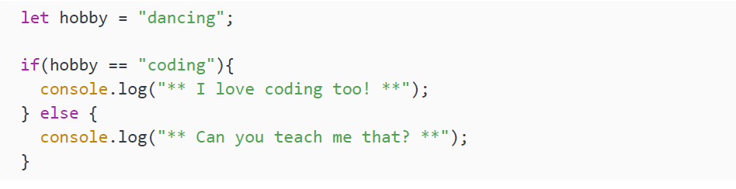
if and if else statements
There is a common coding mistake related to if statements. I have made it in the following code snippet. Can you see what this code does?
It will log the following:

Slide 7
if and if else statements
That might surprise you. The problem here is the single equal sign in the if
statement. Instead of evaluating the condition, it is assigning coding to hobby. And
then it is converting coding to a Boolean, and since it is not an empty string, it will
become true, so the if block will be executed. So, always remember to use the double
equal sign in this case.
Let's test our knowledge with a practice exercise.

Slide 8
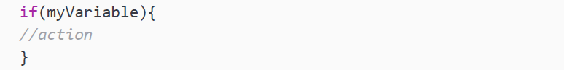
Practice exercise 4.1
Create a variable with a Boolean value.
Output the value of the variable to the console.
Check whether the variable is true and if so, output a message to the console, using the following syntax:
Add another if statement with an ! in front of the variable to check whether the condition is not true, and create a message that will be printed to the console in that instance. You should have two if statements, one with an ! and the other without. You could also use an if and an else statement instead—experiment!
Change the variable to the opposite to see how the result changes.

Slide 9
else if statements
A variation of the if statement is an if statement with multiple else if blocks. This can be more efficient in certain situations because you are always only going to execute one or zero blocks. If you have many if else statements underneath one another, they are going to be evaluated and possibly executed even though one of the ones above already had a condition evaluate to true and proceeded to execute the associated code block.
Here is the written template:
If *a value falls into a certain category*, then *a certain action will happen*, else if *the
value falls into a different category than the previous statement*, then *a certain action will
happen*, else if *the value falls into a different category than either of the previous brackets*,
then *a certain action will happen*

Slide 10
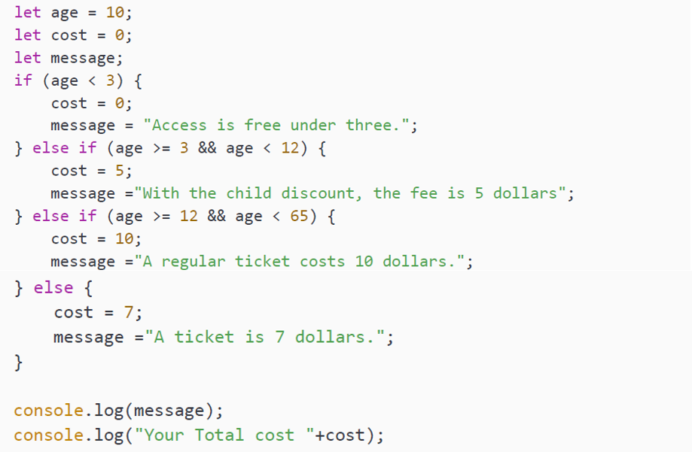
else if statements
For example, take this statement, to determine what the ticket price should be. If a person is younger than 3, then access is free, else if a person is older than 3 and younger than 12, then access is 5 dollars, else if a person is older than 12 and younger than 65, then access is 10 dollars, else if a person is 65 or older, then access is 7 dollars:

Slide 11
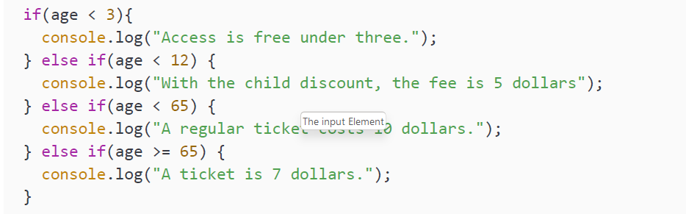
else if statements
Chances are that you will think the code is easier to read than the written template. In that case, nicely done! You are really starting to think like a JavaScript developer already.
The code gets executed top to bottom, and only one of the blocks will be executed. As soon as a true expression is encountered, the other ones will be ignored. This is why we can also write our sample like this:

Slide 12
Practice exercise 4.2
Create a prompt to ask the user's age
Convert the response from the prompt to a number
Declare a message variable that you will use to hold the console message for the user
If the input age is equal to or greater than 21, set the message variable to confirm entry to a venue and the ability to purchase alcohol
If the input age is equal to or greater than 19, set the message variable to confirm entry to the venue but deny the purchase of alcohol
Provide a default else statement to set the message variable to deny entry if none are true
Output the response message variable to the console

Slide 13
Conditional ternary operators
We did not actually discuss this very important operator in our section on operators in Chapter 2, JavaScript Essentials. This is because it helps to understand the if else statement first. Remember that we had a unary operator that was called a unary operator because it only had one operand? This is why our ternary operator has its name; it has three operands. Here is its template:
operand1 is the expression that is to be evaluated. If the value of the expression is true, operand2 gets executed. If the value of the expression is false, operand3 gets executed. You can read the question mark as "then" and the colon as "else" here:
The template for saying it in your head should be:
if *operand1*, then *operand2*, else *operand3*

Slide 14
Conditional ternary operators
Let's have a look at a few examples:
This little code snippet will assign a value to access. If age is lower than 18, then it will assign the value denied, else it will assign the value allowed. You can also specify an action in a ternary statement, like this:
This syntax can be confusing at first. The template of what to say in your head while reading it can really come to the rescue here. You can only use these ternary operators for very short actions, so it's best practice to use the ternary operator in these instances as it makes code easier to read. However, if the logic contains multiple comparison arguments, you'll have to use the regular if-else.

Slide 15
Practice exercise 4.3
Create a Boolean value for an ID variable
Using a ternary operator, create a message variable that will check whether their ID is valid and either allow a person into a venue or not
Output the response to the console

Slide 16
The fieldset Element
The following figure shows the output for the preceding code:
Figure 4.8: Form with fieldset shown in the browser

Slide 17
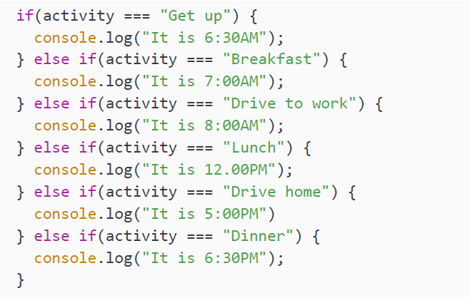
switch statements
If else statements are great for evaluating Boolean conditions. There are many things you can do with them, but in some cases, it is better to replace them with a switch statement. This is especially the case when evaluating more than four or five values.
We are going to see how switch statements can help us and what they look like.
First, have a look at this if else statement:

Slide 18
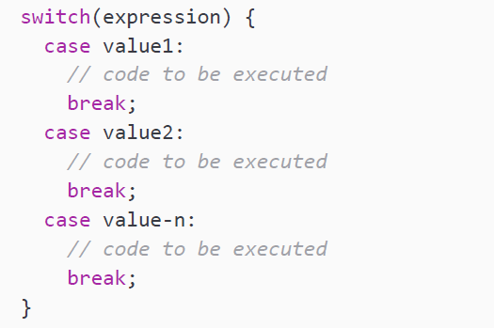
switch statements
It is determining what the time is based on what we are doing. It would be better to implement this using a switch statement. The syntax of a switch statement looks like this:
You can read it in your head as follows: If the expression equals value1, do whatever code is specified for that case. If the expression equals value2, do whatever code is specified for that case, and so on.

Slide 19
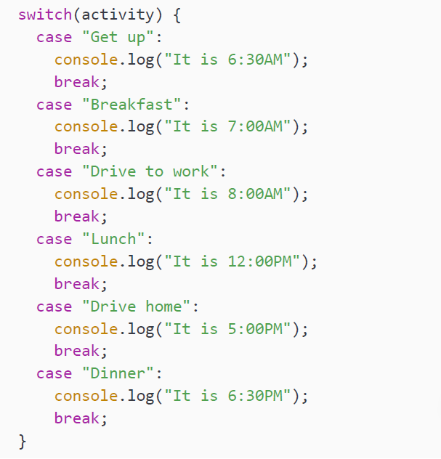
switch statements
Here is how we can rewrite our long if else statement in a much cleaner manner using a switch statement:

Slide 20
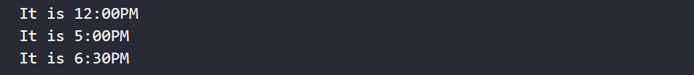
switch statements
If our activity has the value Lunch it will output the following to the console:
What's up with all these breaks, you may be wondering? If you do not use the command break at the end of a case, it will execute the next case as well. This will be done from the case where it has a match, until the end of the switch statement or until we encounter a break statement. This is what the output of our switch statement would be without breaks for the Lunch activity:
One last side note. switch uses strict type checking (the triple equals strategy) to determine equality, which checks for both a value and a data type.

Slide 21
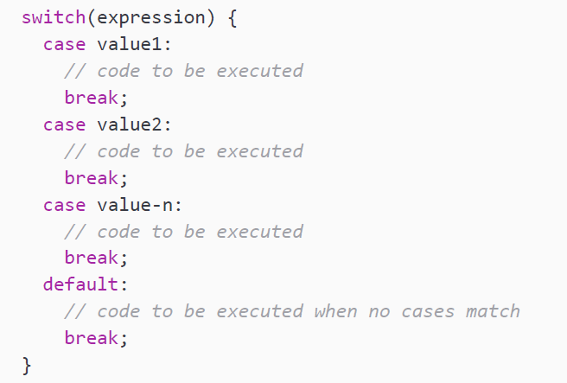
The default case
There is one part of switch that we have not worked with yet, and that is a special case label, namely, default. This works a lot like the else part of an if else statement. If it does not find a match with any of the cases and a default case is present, then it will execute the code associated with the default case. Here is the template of a switch statement with a default case:
The convention is to have the default case as the last case in the switch statement, but the code will work just fine when it is in the middle or the first case. However, we recommend you stick to the conventions and have it as a last case, since that is what other developers (and probably your future self) will expect when dealing with your code later.

Slide 22
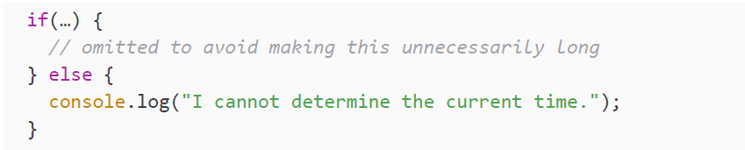
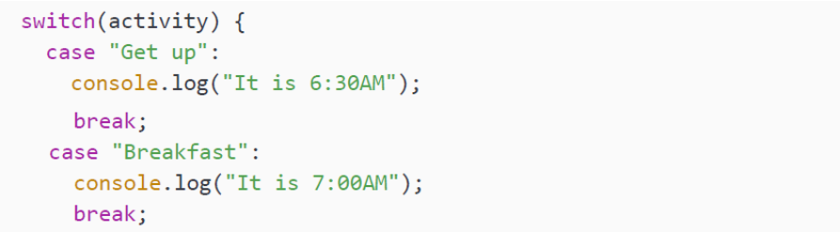
The default case
Let's say our long if statement has an else statement associated with it that looks like this:
The switch statement would then look like this:
Continues on the other slide →

Slide 23
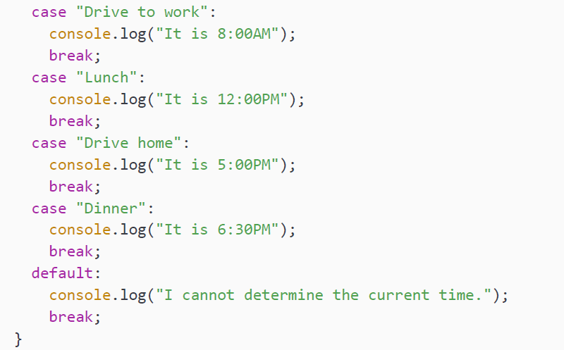
The default case
If the value of the activity was to be something that is not specified as a case, for example, "Watch Netflix," it would log the following to the console:

Slide 24
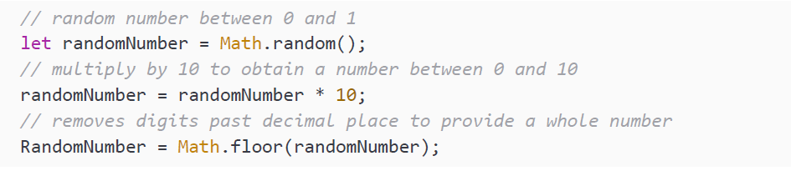
Practice exercise 4.4
As discussed in Chapter 1, Getting Started with JavaScript, the JavaScript function Math.random() will return a random number in the range of 0 to less than 1, including 0 but not 1. You can then scale it to the desired range by multiplying the result and using Math.floor() to round it down to the nearest whole number; for example, to generate a random number between 0 and 9:

Slide 25
Practice exercise 4.4
In this exercise, we'll create a Magic 8-Ball random answer generator:
Start by setting a variable that gets a random value assigned to it. The value is assigned by generating a random number 0-5, for 6 possible results. You can increase this number as you add more results.
Create a prompt that can get a string value input from a user that you can repeat back in the final output.
Create 6 responses using the switch statement, each assigned to a different value from the random number generator.
Create a variable to hold the end response, which should be a sentence printed for the user. You can assign different string values for each case, assigning new values depending on the results from the random value.
Output the user's original question, plus the randomly selected case response, to the console after the user enters their question.

Slide 26
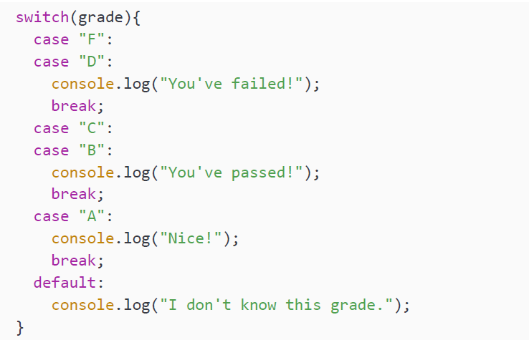
Combining cases
Sometimes, you would want to do the exact same thing for multiple cases. In an if statement, you would have to specify all the different or (||) clauses. In a switch statement, you can simply combine them by putting them on top of each other like this:

Slide 27
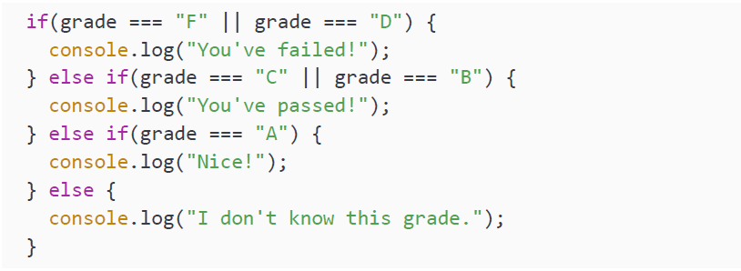
Combining cases
For the values F and D, the same thing is happening. This is also true for C and B. When the value of grade is either C or B, it will log the following to the console:
This is more readable than the alternative if-else statement:

Slide 28
Practice exercise 4.5
Create a variable called prize and use a prompt to ask the user to set the value by selecting a number between 0 and 10
Convert the prompt response to a number data type
Create a variable to use for the output message containing the value "My Selection: "
Using the switch statement (and creativity), provide a response back regarding a prize that is awarded depending on what number is selected
Use the switch break to add combined results for prizes
Output the message back to the user by concatenating your prize variable strings and the output message string

Slide 29
Evaluating a number game
Ask the user to enter a number and check whether it's greater than, equal to, or less than a dynamic number value in your code. Output the result to the user.

Slide 30
Evaluating a number game
Ask the user to enter a name, using the switch statement to return a confirmation that the user is a friend if the name selected is known in the case statements. You can add a default response that you don't know the person if it's an unknown name. Output the result into the console.

Slide 31
Rock Paper Scissors game
This is a game between a player and the computer, where both will make a random selection of either Rock, Paper, or Scissors (alternatively, you could create a version using real player input!). Rock will beat out Scissors, Paper will beat out Rock, and Scissors will beat out Paper. You can use JavaScript to create your own version of this game, applying the logic with an if statement. Since this project is a little more difficult, here are some suggested steps:
Create an array that contains the variables Rock, Paper, and Scissors.
Set up a variable that generates a random number 0-2 for the player and then do the same for the computer's selection. The number represents the index values in the array of the 3 items.
Create a variable to hold a response message to the user. This can show the random results for the player and then also the result for the computer of the matching item from the array.
Create a condition to handle the player and computer selections. If both are the same, this results in a tie.
Use conditions to apply the game logic and return the correct results. There are several ways to do this with the condition statements, but you could check which player's index value is bigger and assign the victory accordingly, with the exception of Rock beating Scissors.
Add a new output message that shows the player selection versus the computer selection and the result of the game.

Slide 32
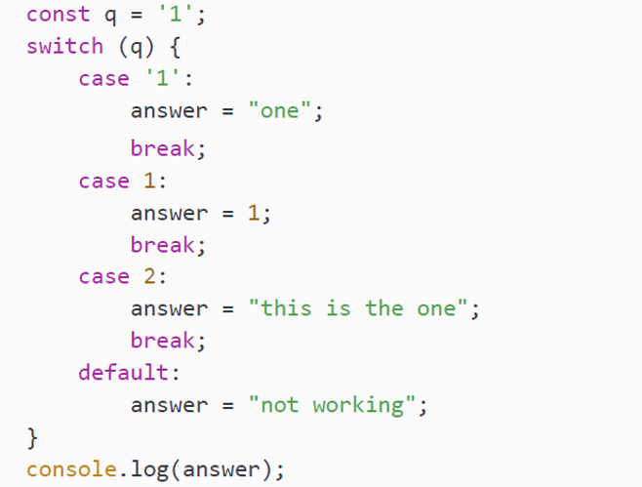
Self-check quiz
1. What will be outputted to the console in this instance?

Slide 33
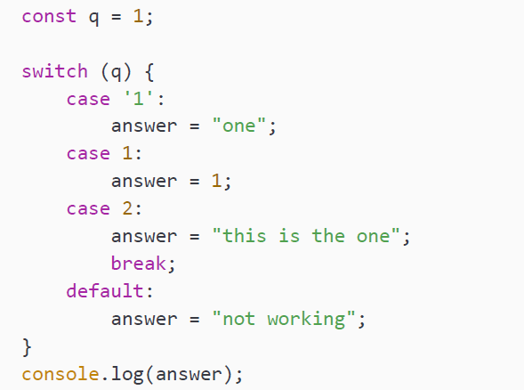
Self-check quiz
2. What will be outputted to the console in this instance?

Slide 34
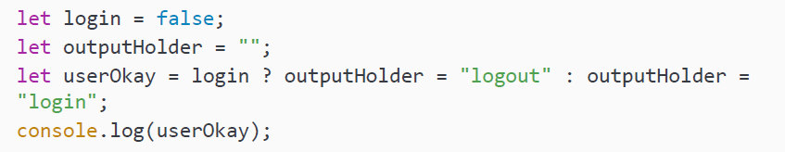
Self-check quiz
3. What will be outputted to the console in this instance?

Slide 35
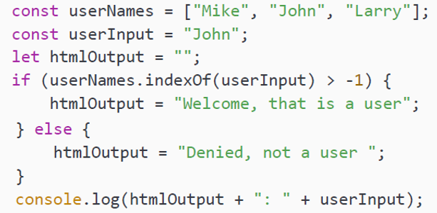
Self-check quiz
4. What will be outputted to the console in this instance?

Slide 36
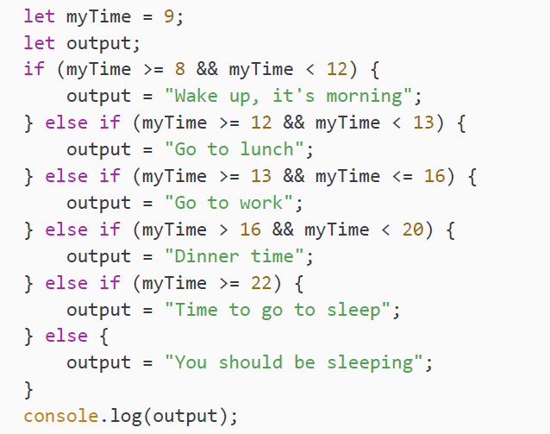
Self-check quiz
5. What will be outputted to the console in this instance?

Slide 37
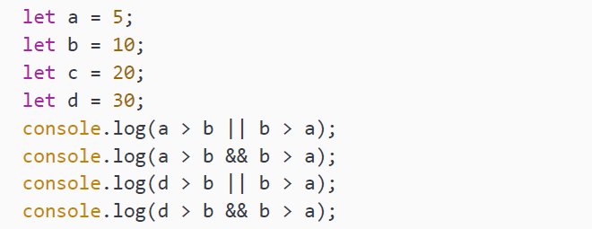
Self-check quiz
6. What will be outputted to the console in this instance?

Slide 38
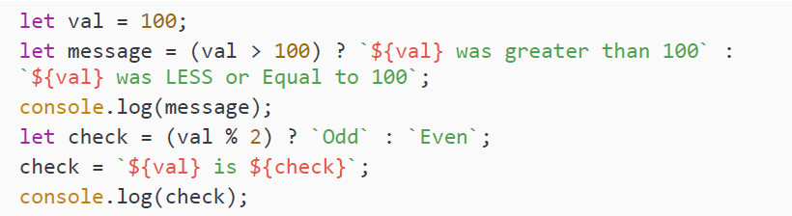
Self-check quiz
7. What will be outputted to the console in this instance?

Slide 39
Summary
Now, let's wrap things up. In this chapter, we have covered conditional statements. We started with if else statements. Whenever the condition associated with the if is true, the if block gets executed. If the condition is false and there is an else block present, that will be executed. We have also seen ternary operators and the funky syntax they bring to the table. It is a short way of writing an if-else statement if you only need one statement per block.
And lastly, we have seen switch statements and how they can be used to optimize our conditional code. With the switch statement, we can compare one condition with many different cases. When they are equal (value and type), the code associated with the case gets executed.
In the next chapter, we are going to add loops to the mix! This is going to help us write more efficient code and algorithms.

